Slide 1

Executive meeting
2004 H2

Slide 2
Agenda
KPI measures
Sales and product overview
Regional overview
Recommendations

Slide 3
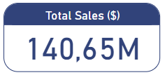
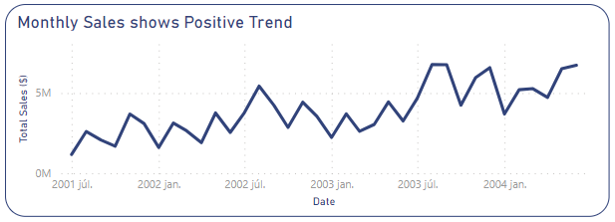
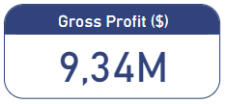
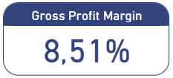
Overview of main KPIs
Notes:
Overall we can see a positive trend in Sales Revenue.

Slide 4
Overview of main KPIs
Notes:
Overall we can see a positive trend in Sales Revenue.

Slide 5
Overview of main KPIs
Notes:
Overall we can see a positive trend in Sales Revenue.

Slide 6
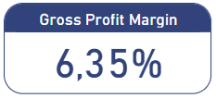
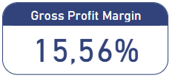
Profit margin is below average
2001-2003:
2004 H1:
2004 H2:
9%
?
Set Target!

Slide 7
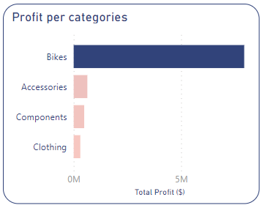
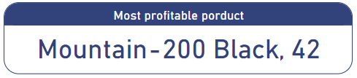
Product overview
Bikes are the most profitable categories. Other categories have very low profit

Slide 8
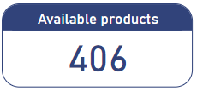
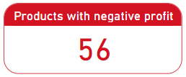

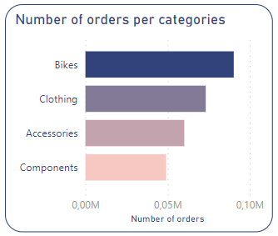
Product overview
(Generates loss)
Possible solutions: - Revise products with negative profit and adjust prices accordingly

Slide 9
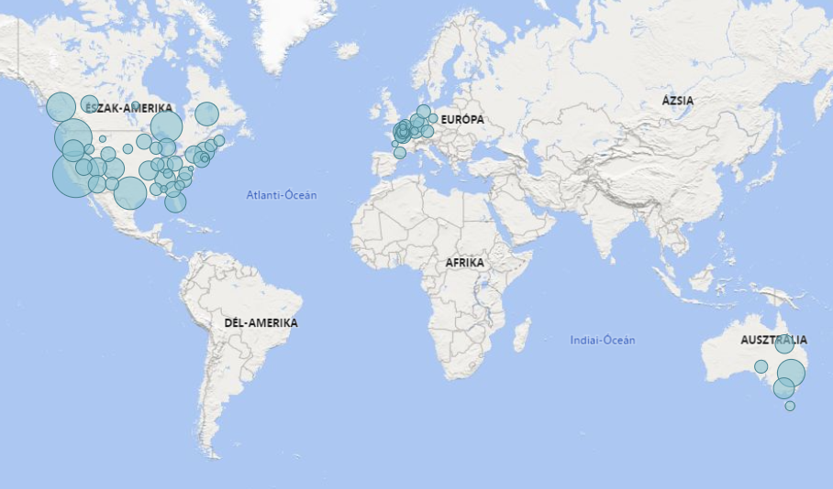
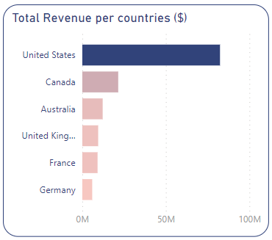
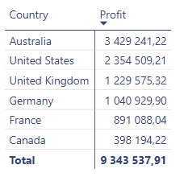
Regions overview
Even though United States generated 50% of the revenue, it is not the most profitable region:
!

Slide 10
Summary of Insights and Recommendations
Profit margin could be increased by the end of year
Set target (departments)
Focus on adjusting product profits – prioritize!

Slide 11
Thank you!

